Slide 1
User guide for AF Project
Online Shopping Cart System for a Fashion Store

Slide 2



1. DOWNLOAD Software
Download NodeJS software from below link
https://nodejs.org/en/download/
Download MongoDB Community Server software from below link
https://www.mongodb.com/download-center/community
Download Git software from below link (Recommended)
https://git-scm.com/downloads
Note: If you have above software in your pc, ignore that software

Slide 3
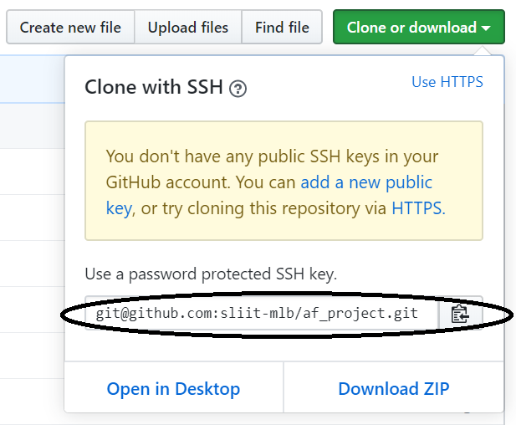
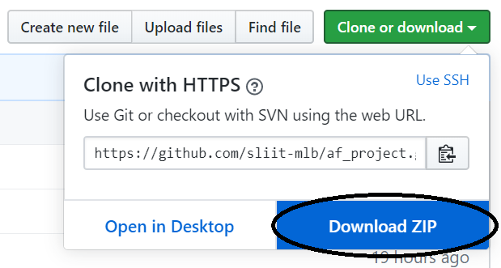
2. Download github repository
Download or Clone Project Repository from below Github link
https://github.com/sliit-mlb/af_project
Download Repository
Clone Repository (Copy this link and paste
to the git bash)

Slide 4

3. Install Software
Install NodeJS
Install MongoDB
Install Git
Install react libraries below command
npm install –g create-react-app
5. Install nodemon globally
npm install –g nodemon
Note: Internet need for 4th, 5th step.

Slide 5


4. Configure project
Extract downloaded zip file
MongoDB configure
Go to following path
Then open server.js file
Change 25th line to your mongodb URI
Then save

Slide 6

5. Install dependencies
Go to following path
Then install dependencies using following command
Then go to backend path
Then install dependencies using following command
Note: Need internet for above npm install steps.

Slide 7
6. Run the Mongodb
Open new command prompt terminal
Then run ‘mongod’ command in that terminal
Note: Don’t close that terminal

Slide 8


6. Run the Project
Initially, run backend
Path
command
Then, run frontend
Path
command
Note: Need internet for running frontend. Some icons are loaded from internet.

Slide 9
7. Load admin and Store manager
Load admin page
http://localhost:{port number}/admin
Username: admin
Password: a9s5d1f2g (see this password in src->Components->Admin->AdminHome.js(line 28))
Load Store Manager page
https://localhost:{port number}/store_manager
Note: when admin create a store manager, after that store manager can login.

